Slide 1
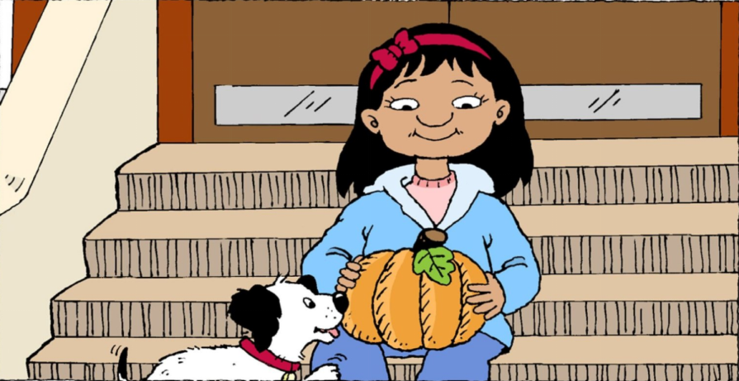
Maria Counts Pumkins.
Maria has one pumkin.

Slide 2
Maria has one pumkin.
Maria has one pumkin.
Return

Slide 3
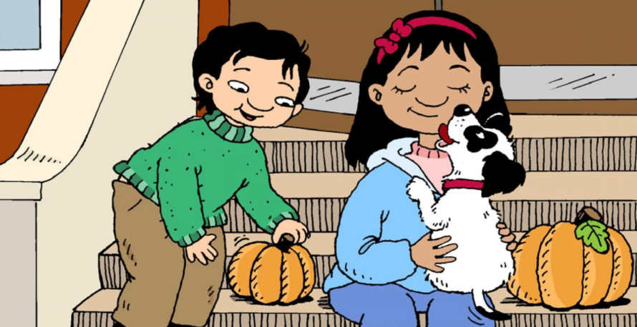
Maria has two pumkins.
Return

Slide 4
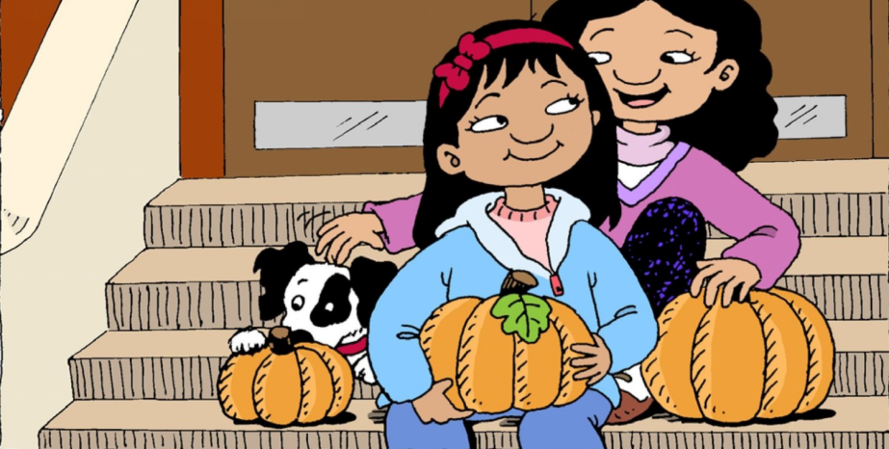
Maria has three pumkins.
Return

Slide 5
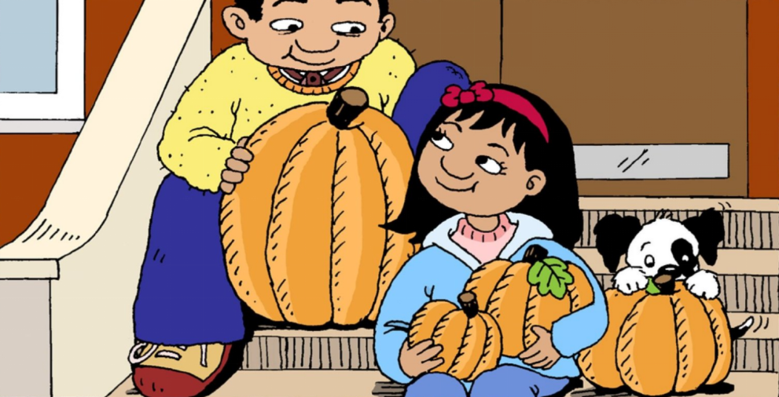
Maria has four pumkins.
Return

Slide 6
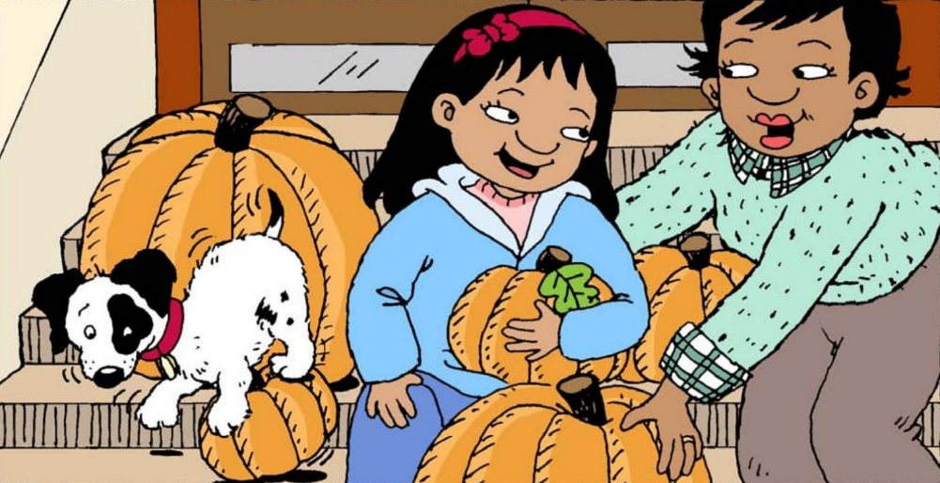
Maria has five pumkins.
Return

Slide 7
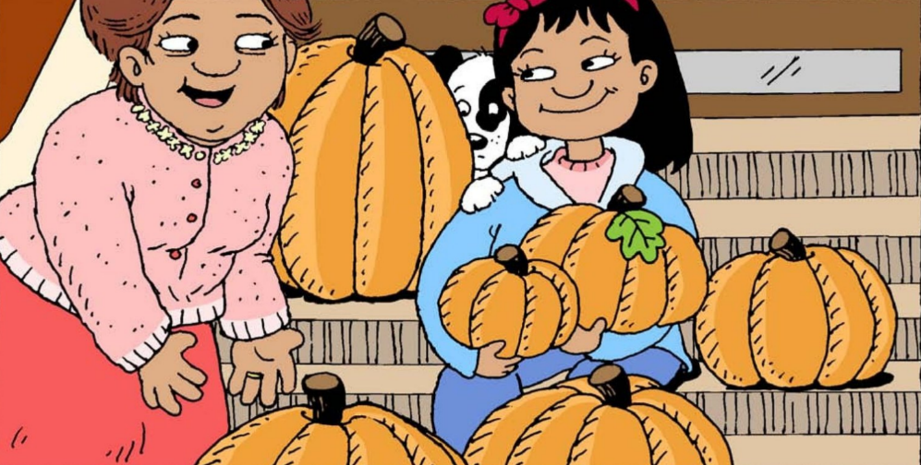
Maria has six pumkins.
Return

Slide 8
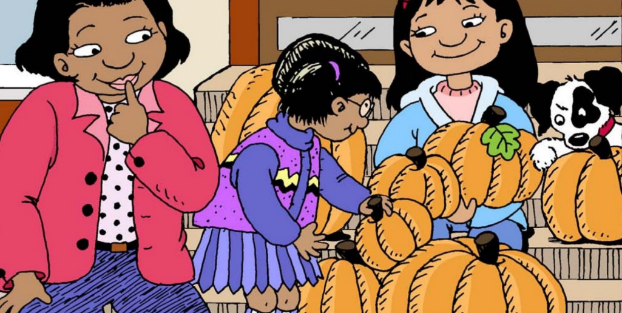
Maria has seven pumkins.
Return

Slide 9
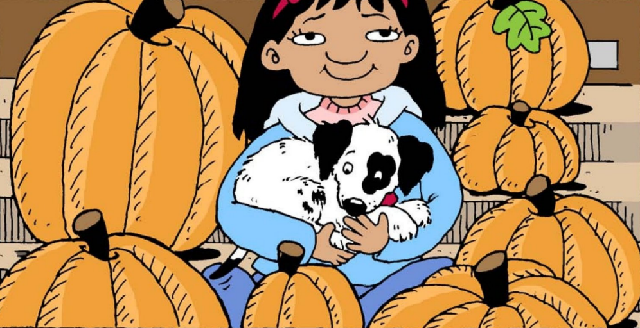
Maria has too many pumkins.
Return

Slide 10
Click on the colored buttons to start getting to know the numbers!
two
three
one
four
five
six
seven

